Slide 1
GUI FOR PRESSURE VESSEL DESIGN
GUIDE BY : - DHAVAL B SHAH
CO GUIDE BY : - ABSAR B LAKDAWALA

Slide 2
FLOW OF THE PRESENTATION
Introduction
Need for the pressure vessel
Requirement for developing of gui
Features included in gui
Study done till review-1

Slide 3
introduction
The pressure vessel is the container design to hold gases and liquid at a pressure different from the ambient pressure.
Pressure vessel is designed to operate at a pressure above 15 P.S.I.G.
They are mainly used to control and maintain constant pressure in the water distribution system.

Slide 4
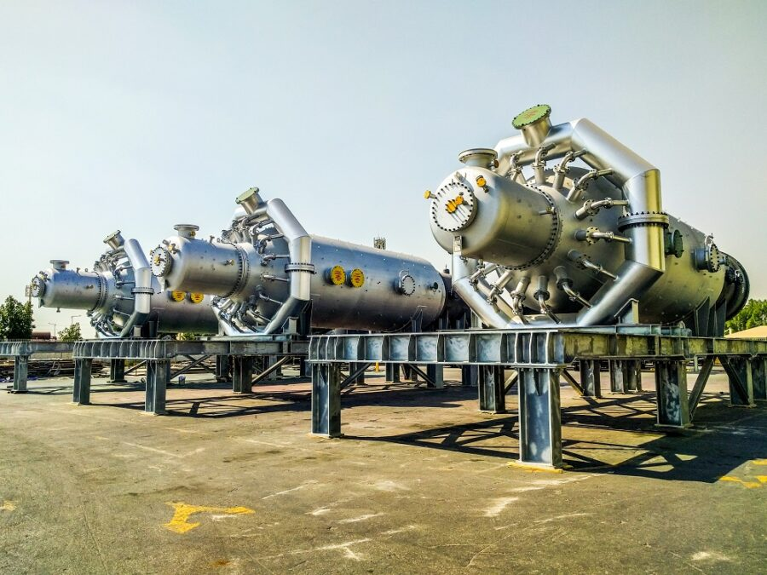
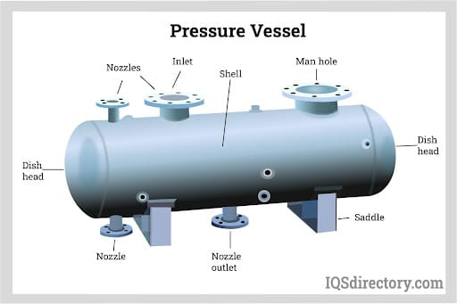
CONTIUNES…
They are also used in chemical, petrochemical, pharmaceutical, oil and fuel, food and beverages industry as well as in heating and cooling systems.

Slide 5
Need for pressure vessel
The main function is to maintain and balance constant pressure in water distribution system , so by balancing it the rapid wear is avoided.
For the toxic and non toxic liquids produce by different industries, the pressure vessels are used as they are carefully fabricated.
The pressure vessel are developed according to the ASME Standards and their regulations, so that industries can work safely as well as under protocols of the government.

Slide 6
requirement for developing GUI
A graphical user interface (GUI) that helps visually understand of the thermal and mechanical design of pressure vessel depending on the pressure, the wind load, the seismic load and fluid level is adequate to accomplish the task with partial ease and for better learn experience.
GUI helps us to get better understanding regarding the pressure vessel design as well as it helps in cost cutting and saves time for the industry which can be use in other beneficiary works.

Slide 7
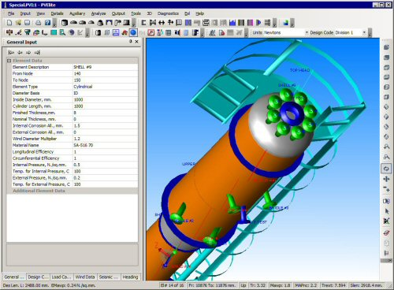

Slide 8
Features included in gui
Thickness
Internal Pressure
External Pressure
Saddle support
Seismic & Wind load design

Slide 9
Work done till review-i
The GUI for the pressure vessel needs a lot of work as well as a lot of study before entering into the code structure and its interface.
The study includes the ASME standards and its survey.
The study is done on:
ASME Section VIII Division I UG section
ASME Section II Part D Customary and Metric
The literature survey is done from the book by Dennis Moss on Pressure vessel design.

Slide 10
Pending work after review-ii
The code structure and the GUI implication is going on from the last week.
The survey has been submitted to our guide and has been approved for the further work.
Within 1-2 weeks the GUI will be prepared.
After that, the test run will be done on different designs.

